Slide 1

BASIC ELECTRICAL AND ELECTRONICS ENGINEERING
Course Code: CSE1002
SCHOOL OF COMPUTER SCIENCE ENGINEERING AND APPLICATIONS
Mrunmayee Rahate
Assistant Professor, DYPIU

Slide 2
Module 2: Semiconductor Devices and Applications
Lecture 1: Introduction to Semiconductors

Slide 3
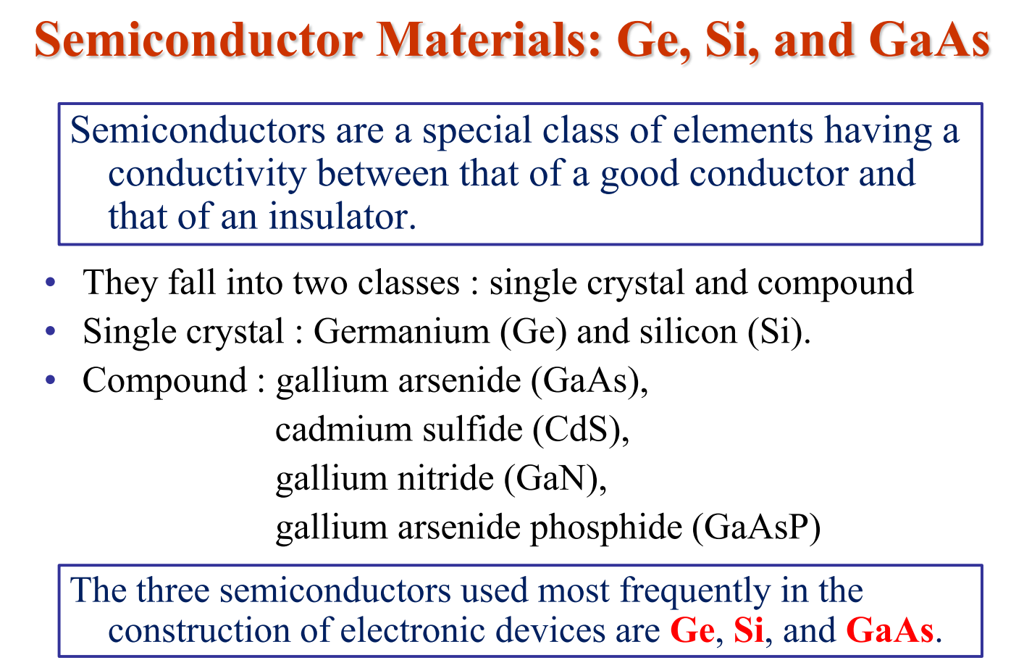

Slide 4
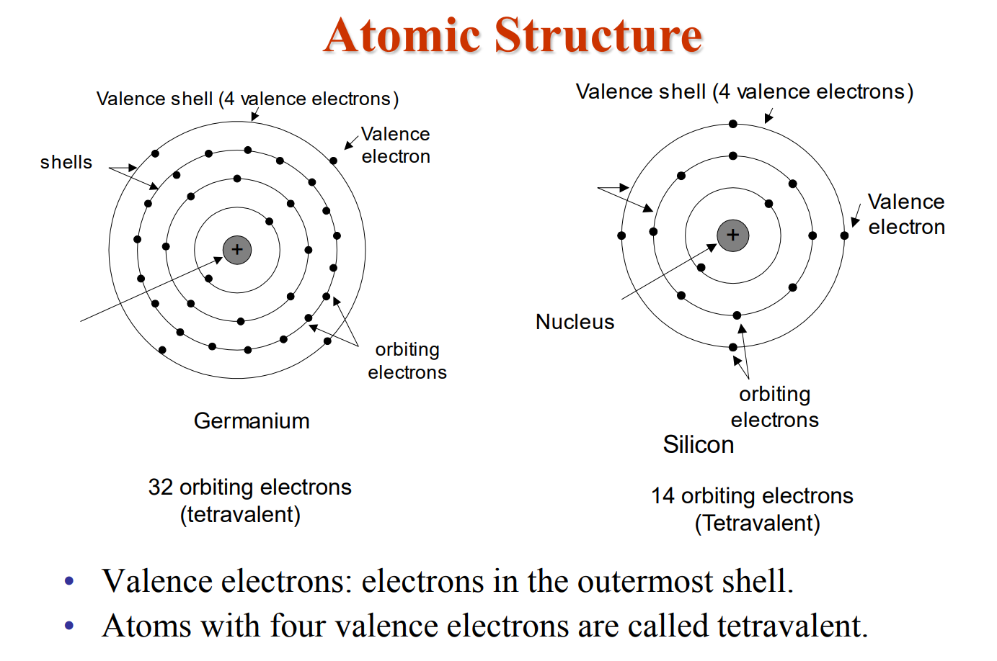
Semiconductor Material
Notes:
Number of electrons in $n^{th }$shell is equal to ${2n}^{2}$.
For most atoms (in Groups 1–18 of the periodic table), stability is achieved when the outermost shell has 8 electrons — this is called the octet rule.
A full shell (8 valence electrons) makes the atom very stable but nonconductive — because there are no free electrons to move.
Conductor: Most conductors have few valence electrons that are loosely bound and can move freely.
Ex: Gold (Au), Silver (Ag), Copper (Cu)) have only 1 valence electron

Slide 5
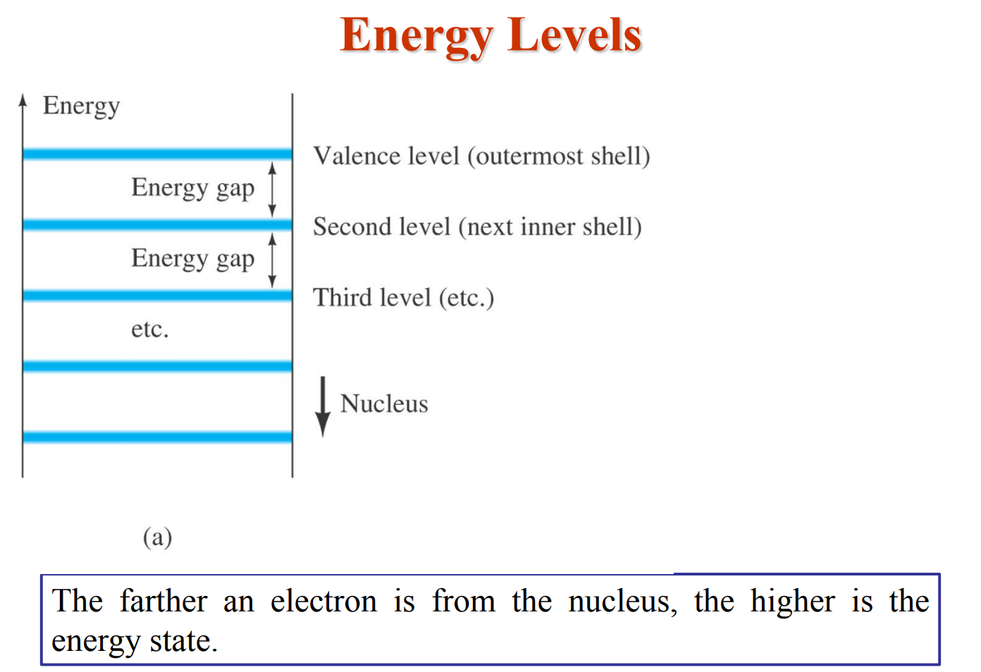

Slide 6
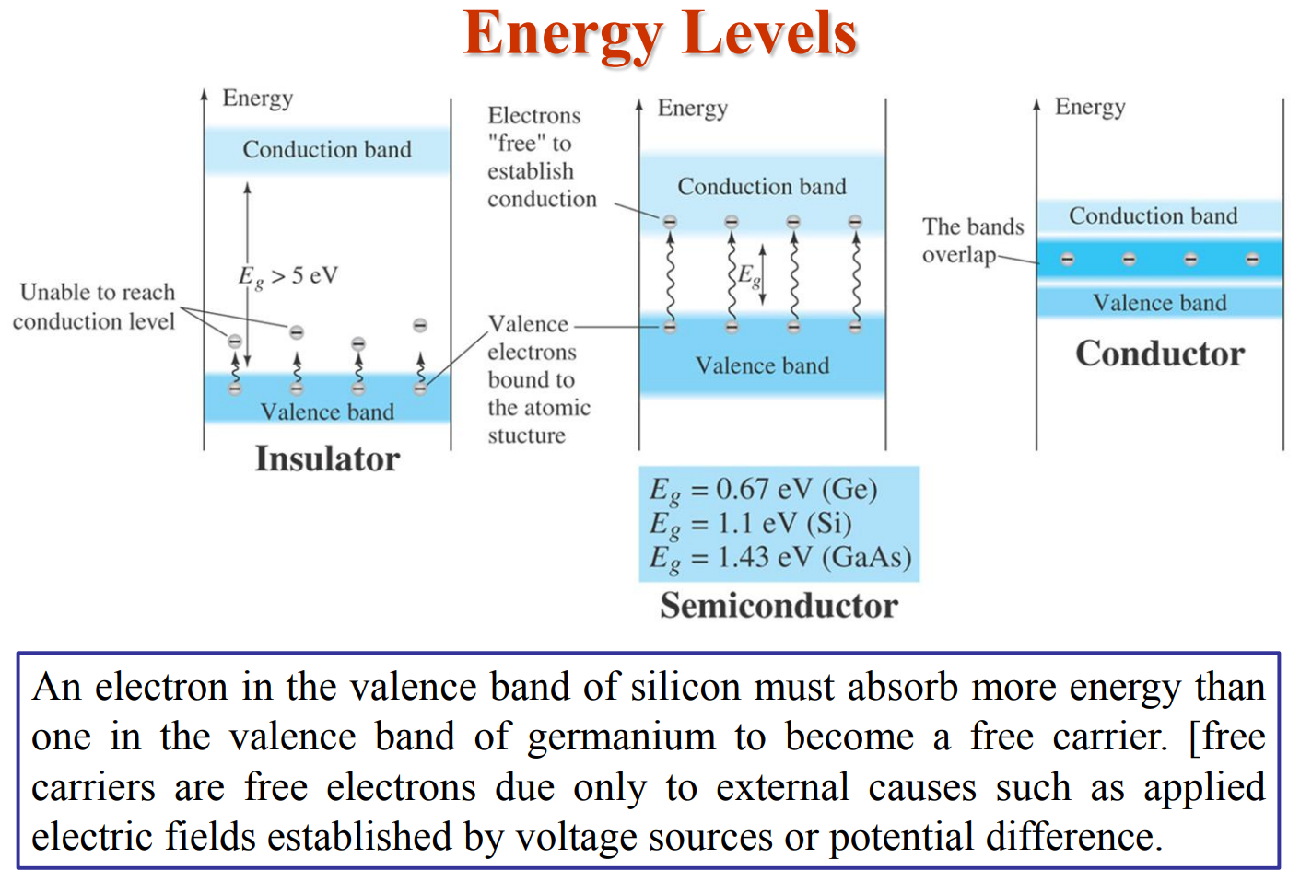

Slide 7
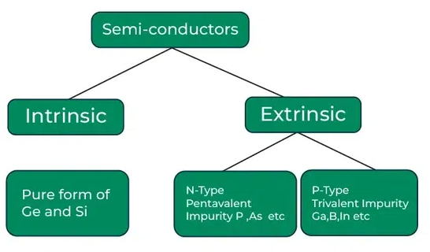
Types of Semiconductor

Slide 8
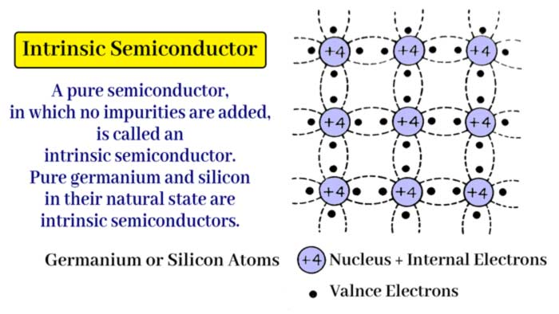
Intrinsic Semiconductor (At $0^{o}$Kelvin)
Stable Crystalline Structure
At low temperatures (near absolute zero), semiconductors act like insulators because all electrons are in the valence band

Slide 9
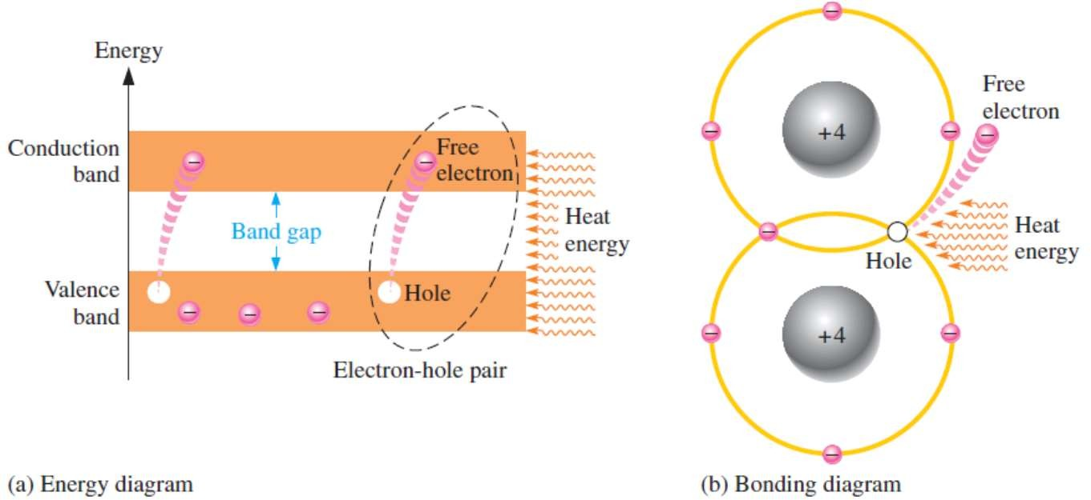
Intrinsic Semiconductor (At Room Temperature)
As a semiconductor is heated, thermal agitation gives electrons enough energy to jump from the valence band to the conduction band
Creates electron-hole pairs in a crystalline structure
Increase in temperature increases the number of free charge carriers (both electrons and holes)

Slide 10
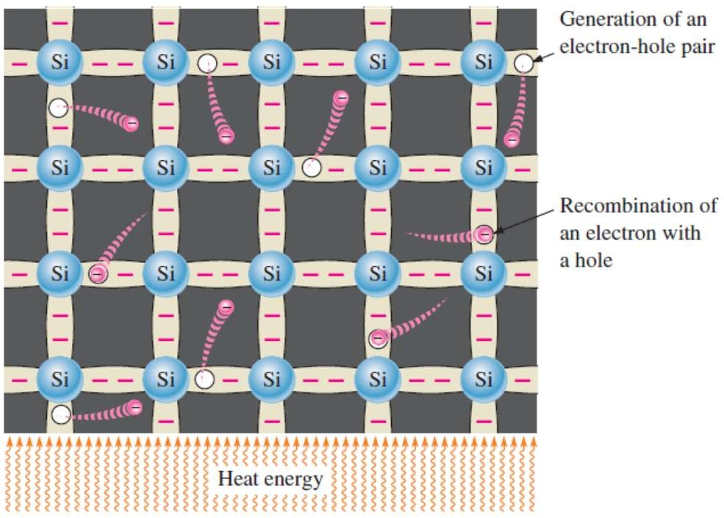
Intrinsic Semiconductor (At Room Temperature)
Free electrons are being generated continuously while some recombine with holes
Conductivity of a semiconductor material increases with the temperature

Slide 11
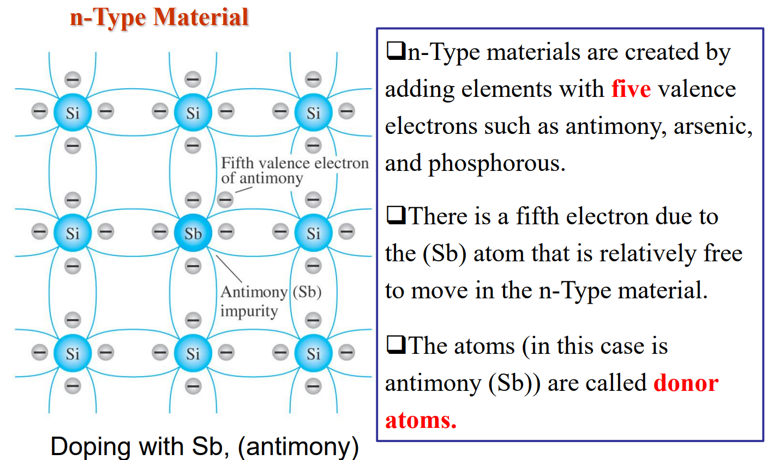
Extrinsic Semiconductor
A large surplus of negative charge carriers are created, making the material much more conductive than it was in its pure, intrinsic state
Notes:
The number of dopant atoms in a semiconductor varies based on the desired electrical conductivity and is typically in a range that is much smaller than the host semiconductor atoms. Low doping levels are around one dopant atom per ${10}^{8}$ or ${10}^{7}$ host atoms, while high doping levels are on the order of one dopant atom per ${10}^{4}$ host atoms.

Slide 12
n-Type Material
Extrinsic Semiconductor
■
Each pentavalent atom (antimony, in this case) forms covalent bonds with four adjacent silicon atoms
Four of the antimony atom’s valence electrons are used to form the covalent bonds with silicon atoms, leaving one extra electron
This extra electron becomes a conduction electron because it is not involved in bonding
Because the pentavalent atom gives up an electron, it is often called a donor atom
The number of conduction electrons can be carefully controlled by the number of impurity atoms added to the silicon
A conduction electron created by this doping process does not leave a hole in the valence band because it is in excess of the number required to fill the valence band

Slide 13
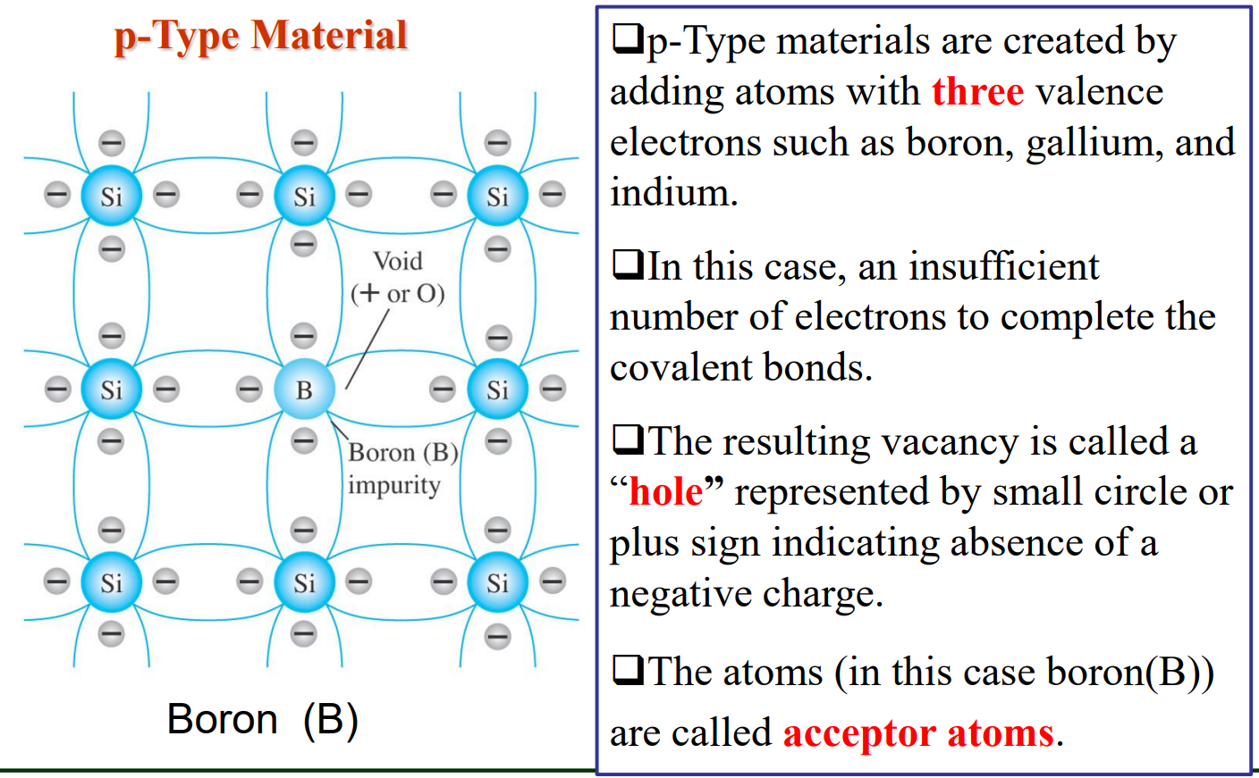
Extrinsic Semiconductor
A large surplus of holes are created, making the material much more conductive than it was in its pure, intrinsic state

Slide 14
p-Type Material
Extrinsic Semiconductor
■
Each trivalent atom (Boron, in this case) forms covalent bonds with four adjacent silicon atoms
Three of the Boron atom’s valence electrons are used to form the covalent bonds with silicon atoms, leaving one extra hole
Because the trivalent atom can take up an electron, it is often called an acceptor atom
The number of holes can be carefully controlled by the number of impurity atoms added to the silicon
A hole created by this doping process is not accompanied by a conduction (free) electron

Slide 15
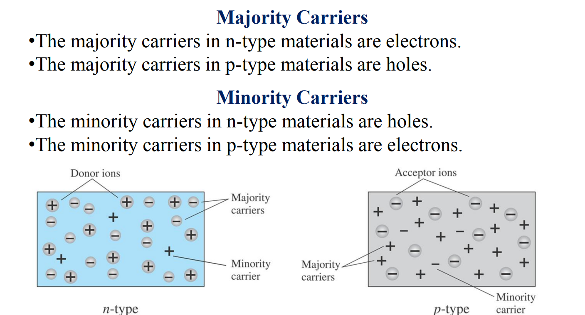
Majority and Minority Carriers
Majority charge carriers are due to thermal agitation + doping
Minority charge carriers are due to thermal agitation only

Slide 16
Thank You !!!

